Slide 1
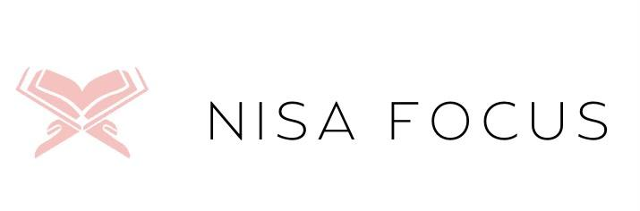
Nisa Focus
By Mariam Ouedraogo

Slide 2


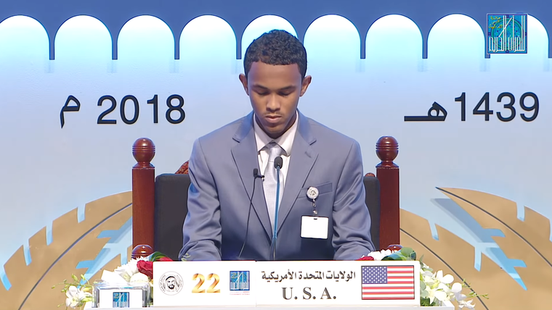



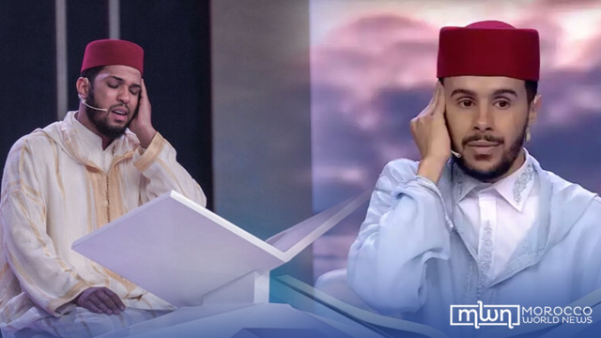
Islamic Culture of Memorizing The Quran

Slide 3
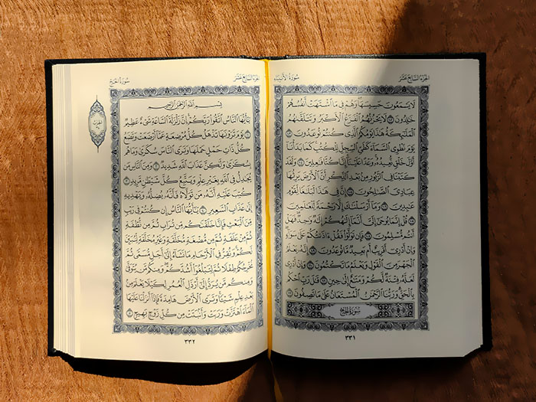

The Qur’an has
604 PAGES

Slide 4
The Qur’an has
114 CHAPTERS

Slide 5
Why would anyone take on such a daunting task?

Slide 6
Fact 1
The Qur’an is believed to be the words of Allah (God). Muslims believe that Allah spoke to Angel Jibreel and Angel Jibreel then revealed the words of Allah to our Prophet Muhammad (pbuh).

Slide 7
Fact 1
Fact 2
The Qur’an is believed to be the words of Allah (God). Muslims believe that Allah spoke to Angel Jibreel and Angel Jibreel then revealed the words of Allah to our Prophet Muhammad (pbuh).
The Arabic word حافظ (Hafidh) means "guardian," "protector," or "preserver." It is commonly used to refer to someone who has memorized the entire Quran by heart. This person has an elevated status for carrying the Qur’an.

Slide 8
Fact 1
Fact 2
Fact 3
The Qur’an is believed to be the words of Allah (God). Muslims believe that Allah spoke to Angel Jibreel and Angel Jibreel then revealed the words of Allah to our Prophet Muhammad (pbuh).
The Arabic word حافظ (Hafidh) means "guardian," "protector," or "preserver." It is commonly used to refer to someone who has memorized the entire Quran by heart. This person has an elevated status for carrying the Qur’an.
The Prophet ﷺ said: "The best among you are those who learn the Qur’an and teach it." (Sahih al-Bukhari, 5027)

Slide 9
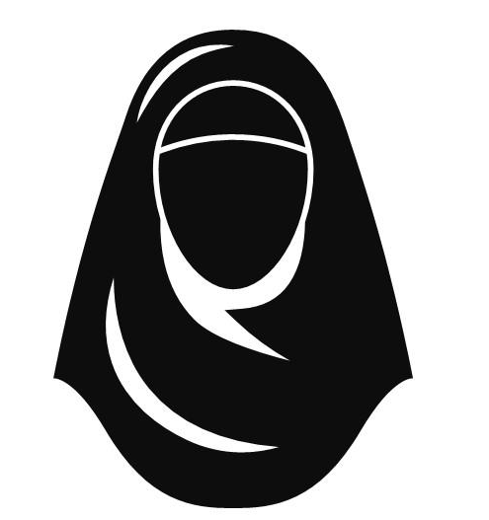
ME
As a student memorizing the Quran, I struggled with maintaining consistency, discipline, and revision. Many Muslim women face similar challenges balancing Quran memorization with daily responsibilities. This inspired me to create a productivity app that caters to their needs.

Slide 10
Problem Statement!
Muslim women who memorize the Quran often face challenges with consistency, distractions, and structured revision.
While this may seem like a matter of discipline, many women lack safe and supportive spaces where they can be encouraged and motivated by other Muslim women on the same journey.

Slide 11
Nisa Focus ͢
Women Focus
Arabic phrase

Slide 12
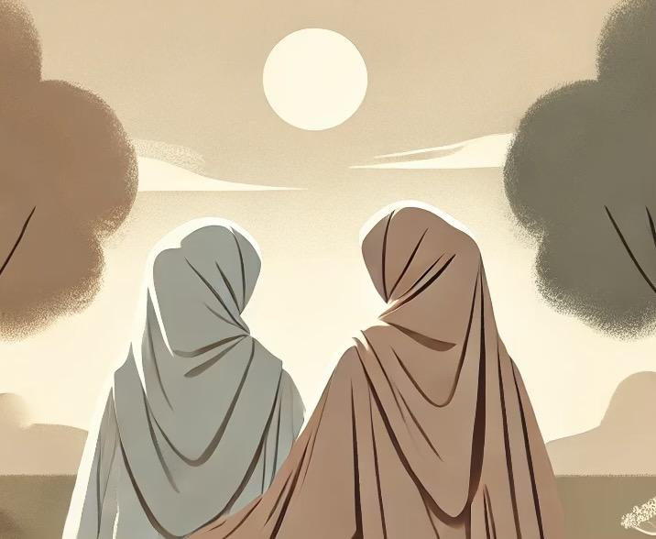
Introduction:
Nisa Focus
Nisa Focus is a platform designed to support Muslim women in their Quran memorization and revision journey by fostering a strong, encouraging community.
An overwhelming number of Muslim women struggle with motivation and consistency due to isolation.
Inspired by the Prophet Muhammad’s (ﷺ) emphasis on companionship, Nisa Focus connects women through reminders, group support, and access to Female Quran teachers—ensuring that no one walks this path alone.

Slide 13
But I didn’t start here!

Slide 14

Original Project:
Édu Plan
Addressing lesson planning inefficiencies and technology gaps in Burkina Faso’s elementary schools.
Limitations:
Requires me to be physically in West Africa
Lack of access to teachers
Teachers unwillingness to show me lesson plans

Slide 15
Pivot
Look at your network and go where you are valued, wanted, and supported!
Think: religion, ethnicity, race, family, etc
Notes:
I tapped into my religious circel

Slide 16

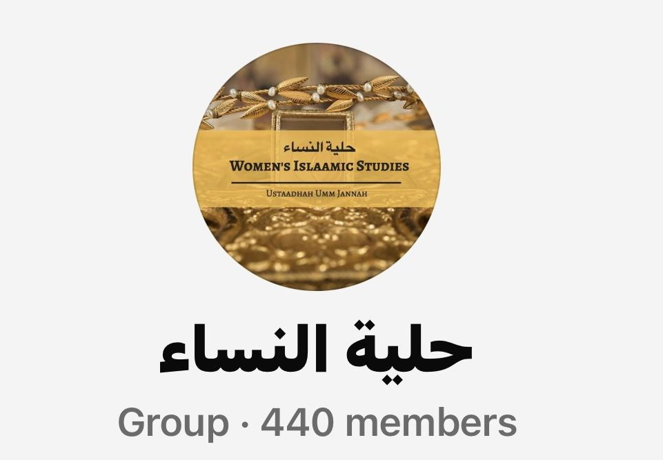
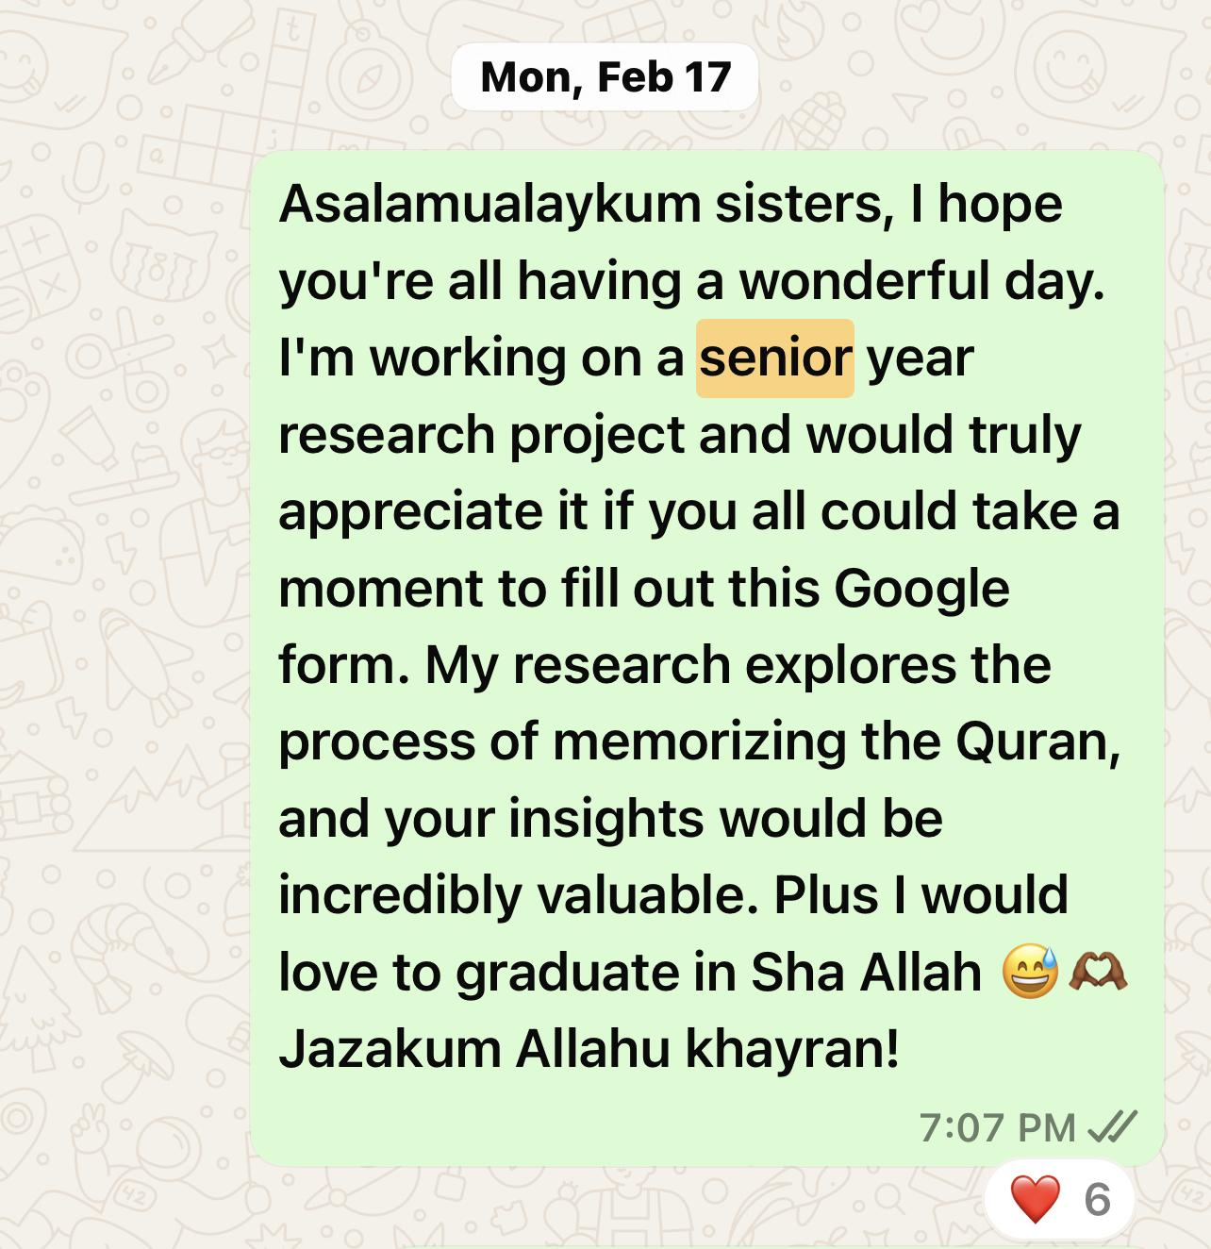
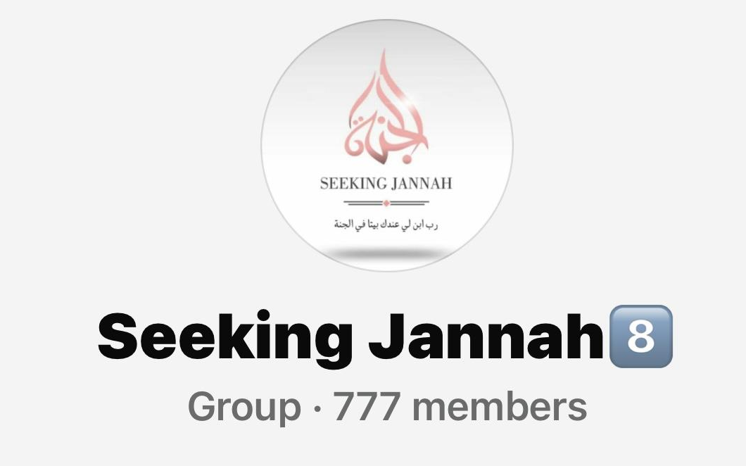
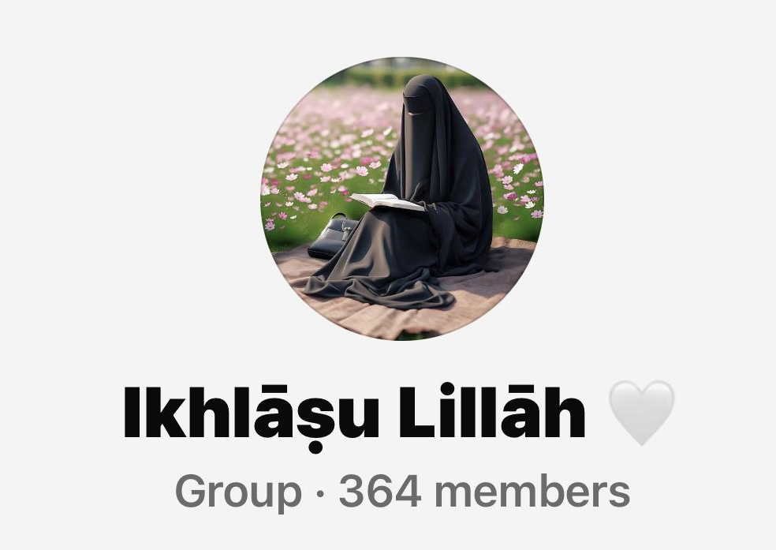
Network:
Religion

Slide 17
User Research
1
2
34 GOOGLE FORM
RESPONSES
10 + INTERVIEWS
I COMPLETED THIS IN
A WEEK 😱

Slide 18
Google Responses
“It’s sometimes easy to pick up the book and read a just one day but continuing that the whole week is where it gets tricky”
“Forgetting what I’ve memorized. Revision is everything! “
“the psychological block of thinking I can’t do it, or demotivating energy “
“Procrastination! I think most people struggle with this a lot!
“Finding a consistent time to memorize”
1
2
3
4
5

Slide 19
Competitors
Tarteel
Qur’an Companion
Features: Voice-recognition (ai powered), memorization tracking, correction feature for mistakes
Features: Gamified memorization, leaderboards
Quran.com
Features: Read, listen, search the Qur’an; tafsir access
COMMON Weakness:
No female-focused community or mentorship
Notes:
Competitive Landscape
1. Tarteel AI
Features: Voice-recognition, memorization tracking
Weaknesses: No female-focused community or mentorship
2. Quran.com
Features: Read, listen, search the Qur’an; tafsir access
Weaknesses: No memorization tracking or community features
3. Quran Companion
Features: Gamified memorization, leaderboards
Weaknesses: Feels more like a solo game; lacks real community support

Slide 20
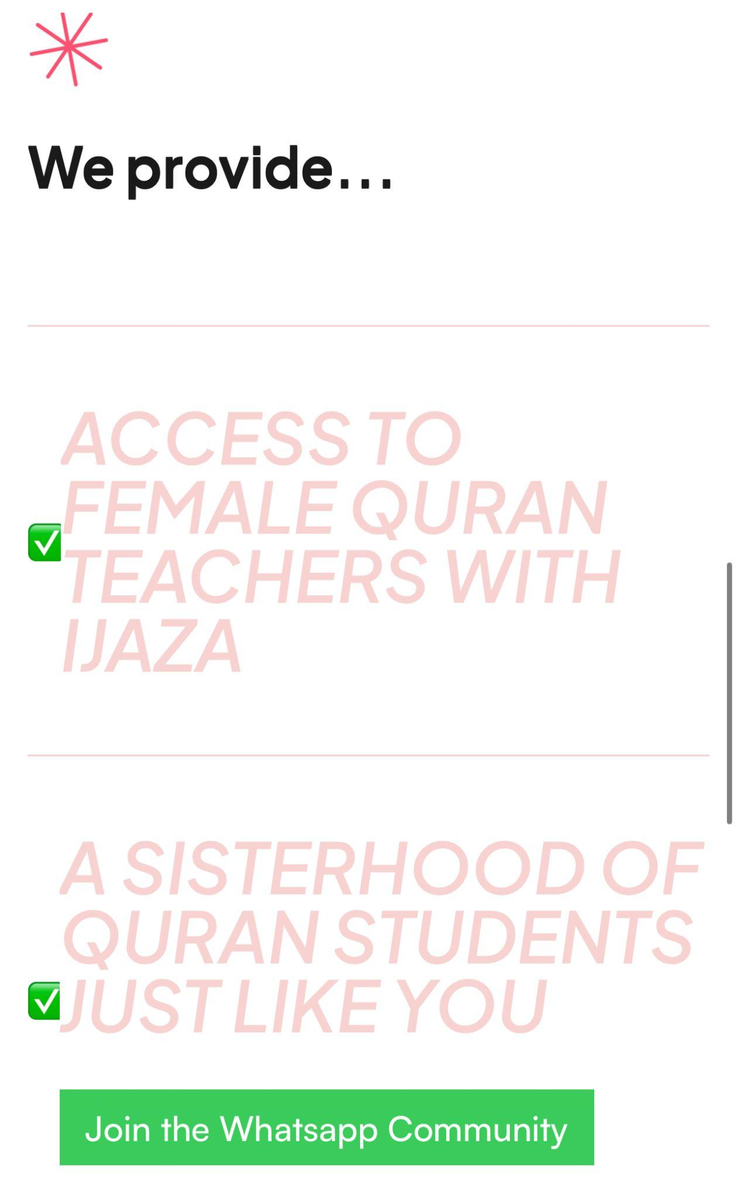
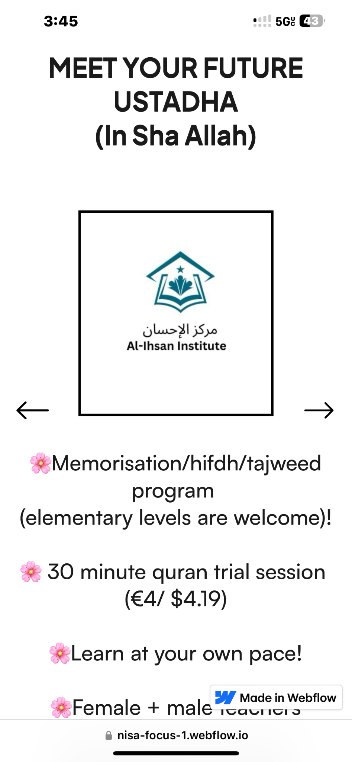
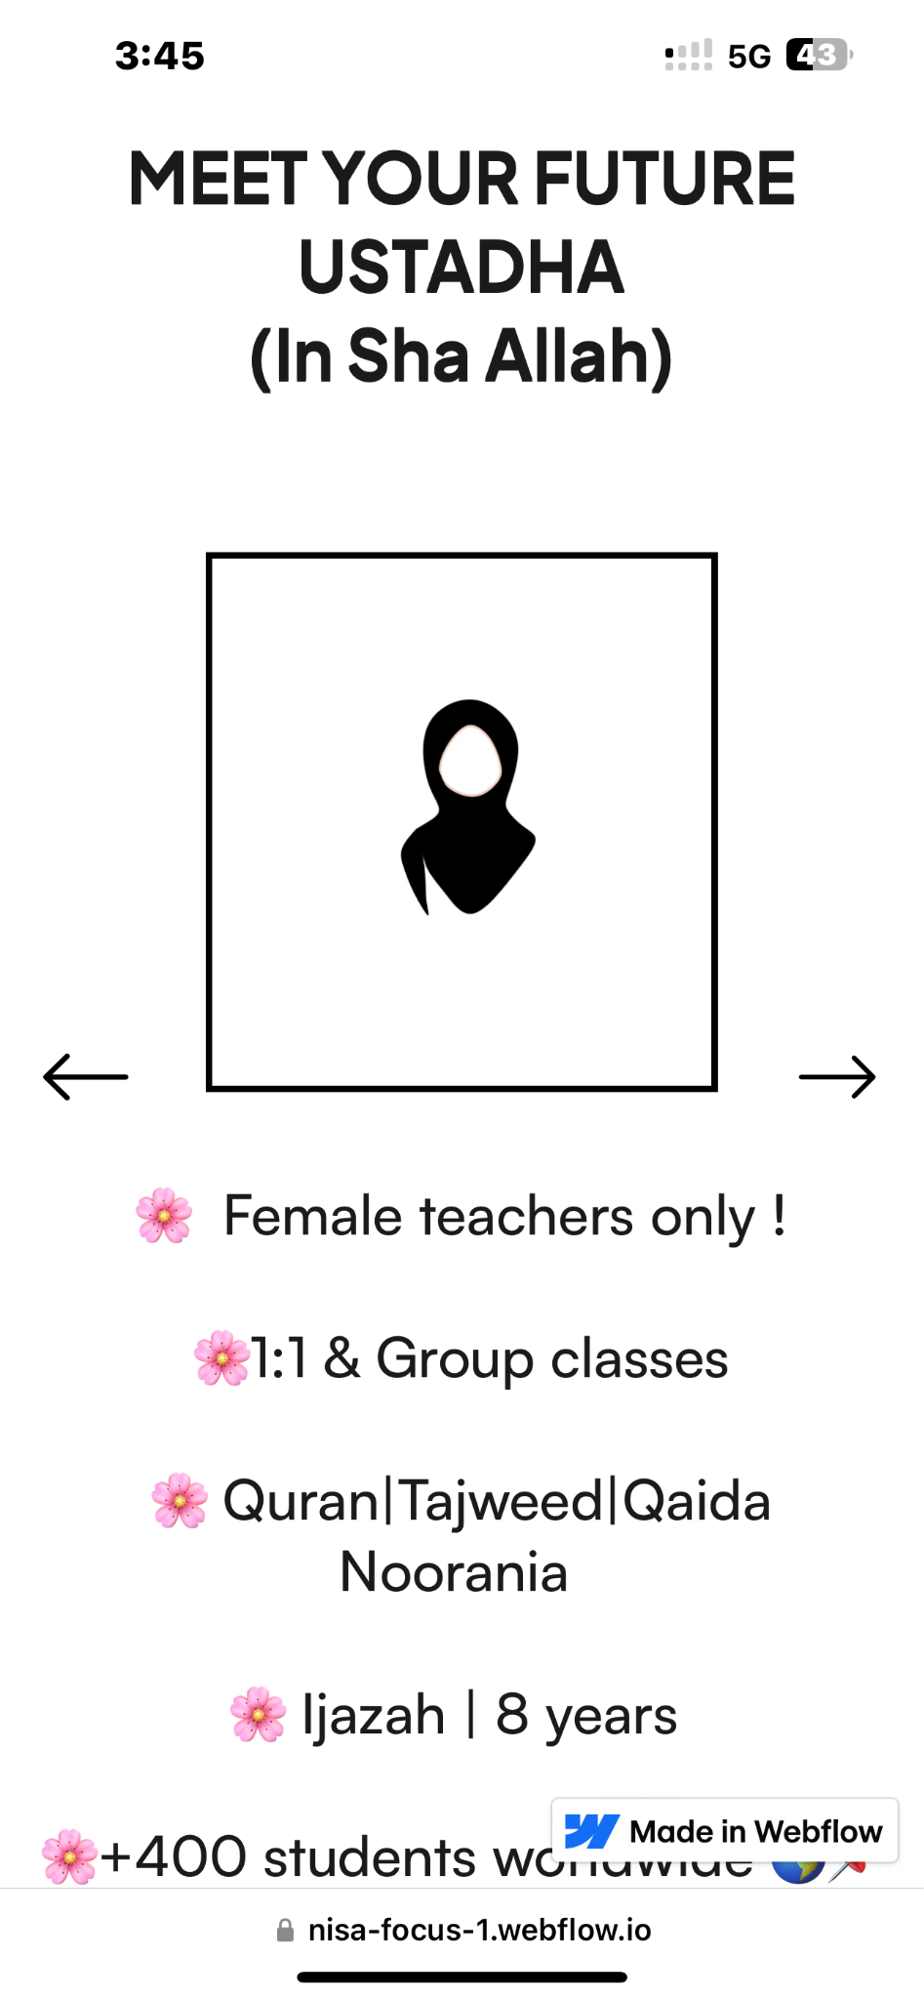
Exhibit 3 : Web Page
What makes us Unique?

Slide 21
2 BILLION MUSLIMS
TAM (Total Addressable Market)

Slide 22
2 BILLION MUSLIMS
MUSLIM WOMEN (50%)
1 BILLION
TAM (Total Addressable Market)

Slide 23
✅ Step 1: Total Muslim Women in the U.S.
Total U.S. Muslim population: ~3.45 million (Pew, 2017)
Roughly 50% are women → ~1.7 million Muslim women
✅ Step 2: Internet & Smartphone Penetration
U.S. smartphone usage among women: ~94% (Pew Research, 2023)
Internet access among U.S. adults: ~93–95% (Statista, Pew)
Assume a conservative estimate (90%) for Muslim women.
✅ Estimated Digitally Connected Muslim Women
1.7 million × 90% = ~1.53 million digitally connected Muslim women in the U.S.
TARGET: DIGITALLY CONNECT MUSLIM WOMEN
Notes:
🇺🇸 Muslim Women in the U.S. (Digitally Connected)
✅ Step 1: Total Muslim Women in the U.S.
Total U.S. Muslim population: ~3.45 million (Pew, 2017)
Roughly 50% are women → ~1.7 million Muslim women
✅ Step 2: Internet & Smartphone Penetration
U.S. smartphone usage among women: ~94% (Pew Research, 2023)
Internet access among U.S. adults: ~93–95% (Statista, Pew)
Assume a conservative estimate (say 90%) for Muslim women due to possible variation by age or immigrant status.
✅ Estimated Digitally Connected Muslim Women
1.7 million × 90% = ~1.53 million digitally connected Muslim women in the U.S.

Slide 24
Current Reach: We’ve engaged 30+ users via WhatsApp group in the past month
Engagement Rate: Average 6 reactions per post (20% of users)
Open Rate: Average 25 (83.3% of users)
Impact
According to Forbes “SMS has a staggering 98% open rate. That’s 3.7x more than the 26.8% open rate for email”
Notes:
🇺🇸 Muslim Women in the U.S. (Digitally Connected)
✅ Step 1: Total Muslim Women in the U.S.
Total U.S. Muslim population: ~3.45 million (Pew, 2017)
Roughly 50% are women → ~1.7 million Muslim women
✅ Step 2: Internet & Smartphone Penetration
U.S. smartphone usage among women: ~94% (Pew Research, 2023)
Internet access among U.S. adults: ~93–95% (Statista, Pew)
Assume a conservative estimate (say 90%) for Muslim women due to possible variation by age or immigrant status.
✅ Estimated Digitally Connected Muslim Women
1.7 million × 90% = ~1.53 million digitally connected Muslim women in the U.S.

Slide 25
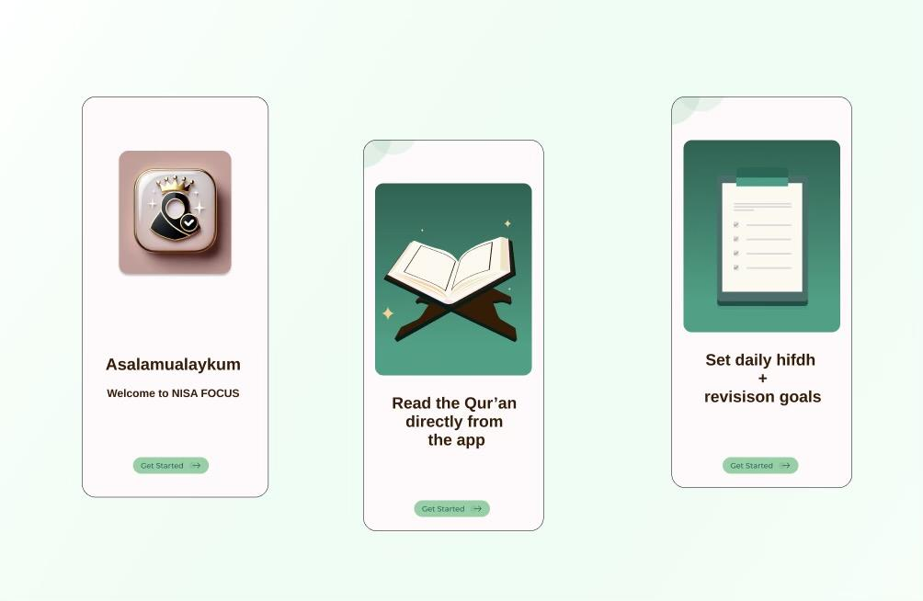
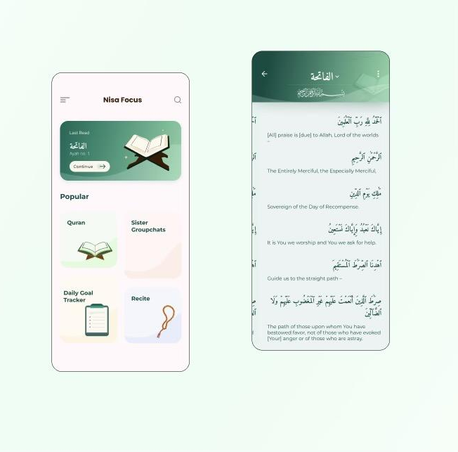
Exhibit 1: App Wireframes
1
3
4

Slide 26
MAYBE AN APP WASN’T THE BEST IDEA
(For Now)
LEARNING CURVE🛑

Slide 27
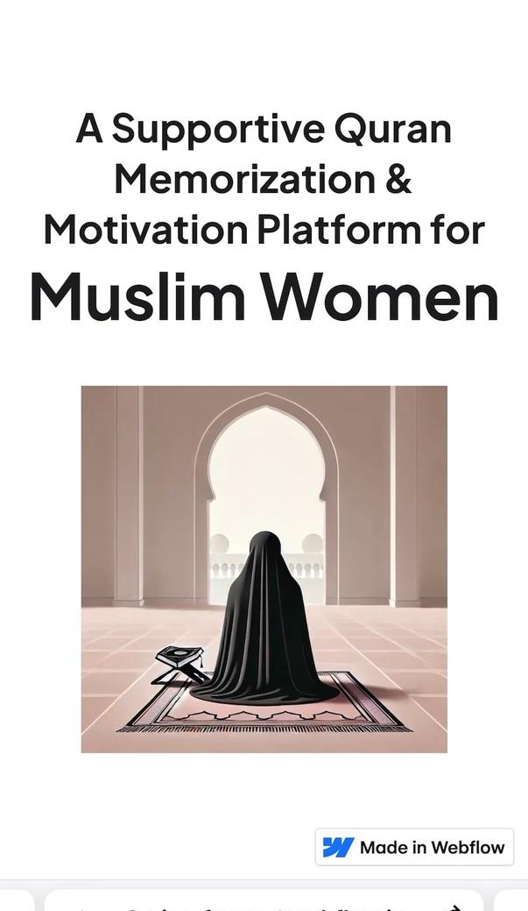
Exhibit 2 : Web page
https://nisa-focus-1.webflow.io/

Slide 28
Exhibit 3 : Web Page
What makes us Unique?

Slide 29
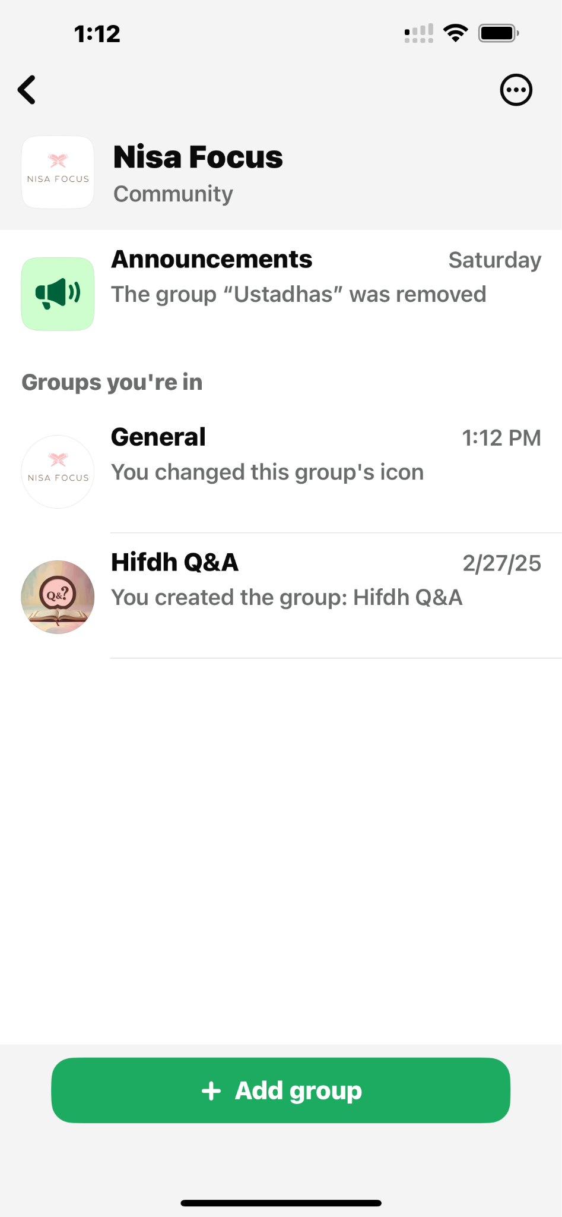
Exhibit 4 : Whatsapp

Slide 30
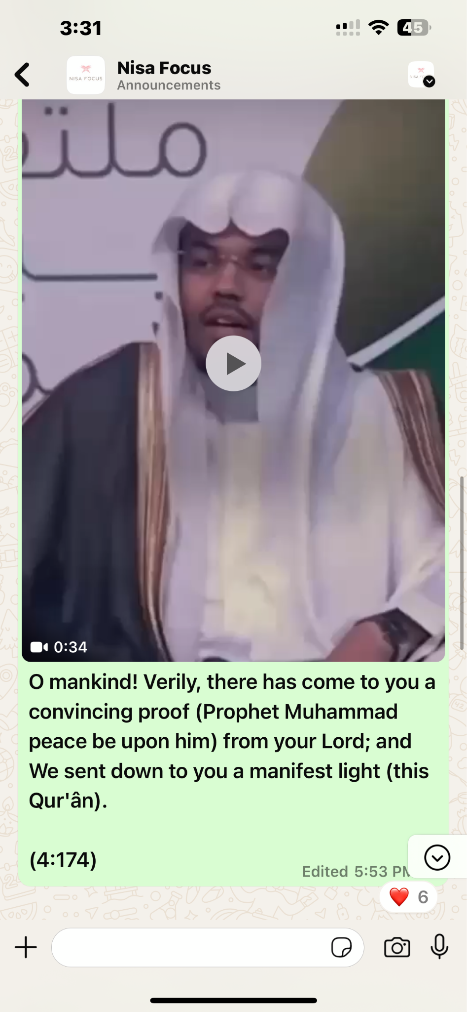
Exhibit 5 : Whatsapp
Activity

Slide 31
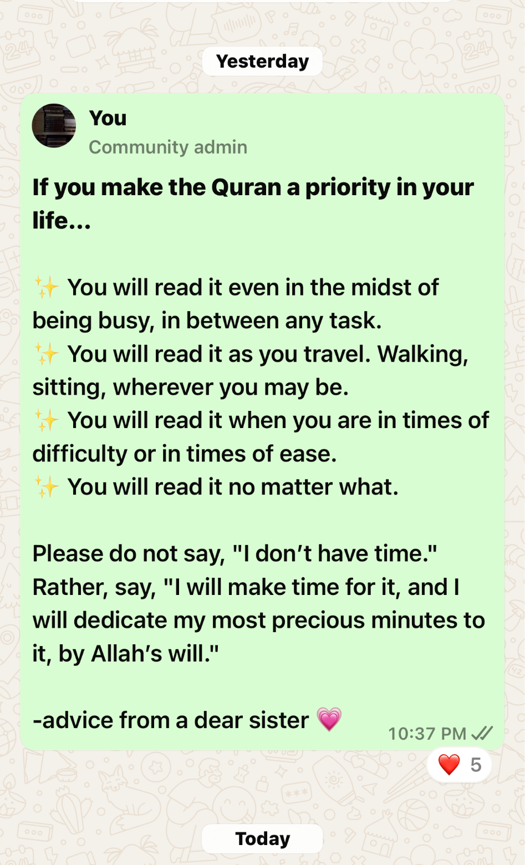
Exhibit 6 : Whatsapp
Activity

Slide 32
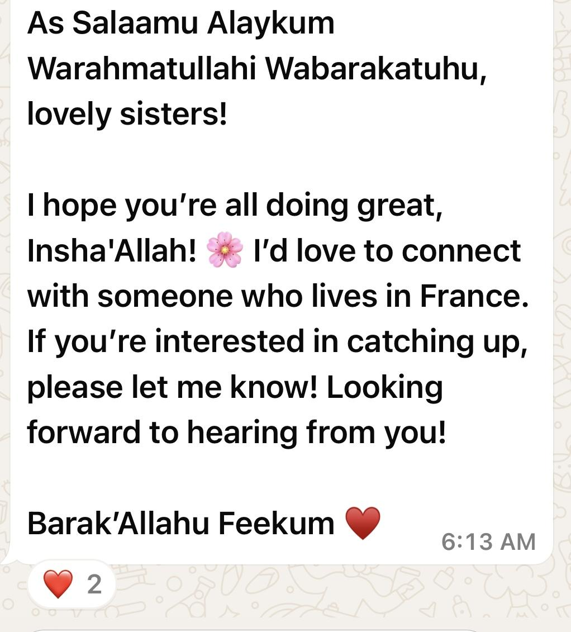
Exhibit 6 : Whatsapp
Activity
Nisa Focus is going Global 😎

Slide 33
NEXT STEPS
1
2
3
4
Technical expertise
Live meetings
Sisters can communicate LIVE!
Quran api (accessible)
App developer
Q & A
Donate
Section on the website dedicated for donations to Palestine, orphanages, etc.
Hifdh Q&A
Sisters can get their revision and memorization questions answered by a teacher !

Slide 34
Phase 1: MVP Web App
Frontend: React / Webflow for fast prototyping
Backend: Firebase or Supabase
APIs: Use existing Qur’an APIs (like AlQuran Cloud)
Team Roles Needed:
Frontend Dev: UI/UX implementation
Backend Dev: Authentication, data storage
QA Tester: Ensures smooth performance
AI Integration (future): Reminders & smart revision using GPT-powered logic
How We’ll Build It
Timeline:
MVP in 3–4 months
Full App with payment + social features in 8–10 months
Notes:
🇺🇸 Muslim Women in the U.S. (Digitally Connected)
✅ Step 1: Total Muslim Women in the U.S.
Total U.S. Muslim population: ~3.45 million (Pew, 2017)
Roughly 50% are women → ~1.7 million Muslim women
✅ Step 2: Internet & Smartphone Penetration
U.S. smartphone usage among women: ~94% (Pew Research, 2023)
Internet access among U.S. adults: ~93–95% (Statista, Pew)
Assume a conservative estimate (say 90%) for Muslim women due to possible variation by age or immigrant status.
✅ Estimated Digitally Connected Muslim Women
1.7 million × 90% = ~1.53 million digitally connected Muslim women in the U.S.

Slide 35
Freemium Model:
Basic features free
Premium content: $5/month for structured revision plans, expert one one one Q&A sessions, & goal-tracking tools
Donations:
Optional donations support scholarships, platform upgrades, and community initiatives
Grants/Partnerships:
Applying for funding from Islamic education NGOs and tech-for-good grants
Partnering with local mosques and Quran circles for live events
Sustainable Growth Model
Notes:
🇺🇸 Muslim Women in the U.S. (Digitally Connected)
✅ Step 1: Total Muslim Women in the U.S.
Total U.S. Muslim population: ~3.45 million (Pew, 2017)
Roughly 50% are women → ~1.7 million Muslim women
✅ Step 2: Internet & Smartphone Penetration
U.S. smartphone usage among women: ~94% (Pew Research, 2023)
Internet access among U.S. adults: ~93–95% (Statista, Pew)
Assume a conservative estimate (say 90%) for Muslim women due to possible variation by age or immigrant status.
✅ Estimated Digitally Connected Muslim Women
1.7 million × 90% = ~1.53 million digitally connected Muslim women in the U.S.

Slide 36
Success, for me, isn’t just about numbers or downloads.
It’s when a sister sees a notification from Nisa Focus at just the right time, and it gently reminds her to reconnect with the Qur’an.
It’s when she opens the mushaf after a long day, not out of guilt, but because she feels supported, seen, and spiritually uplifted. If even one woman feels more confident, more consistent, or more connected to Allah through this platform, then I know this work has purpose.
THANK YOU 💗

